Slide 1



Revision Tips
C Johnston 2018

Slide 2

Method:
Everyone is different.
Try different methods.
There is no right way to revise.

Slide 3
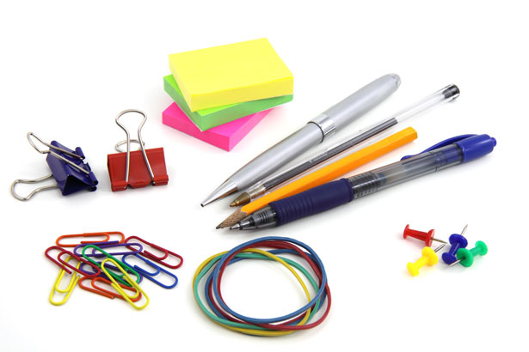
Getting ready:
Get prepared:
Revising will feel better with the right equipment!
Pens and pencils; different colours;
Highlighters, felt pens;
A4 or A3 folders to store your class notes and revision notes;
Document or cardboard wallets;
Plastic wallets;
Exercise books or notepads;
File paper;
A5 or A6 Revision cards;
A3 or A4 plain or coloured paper;
Wall paper for timelines;
Post It notes;
Recording device (to play back)

Slide 4

Avoid all distractions:.
Keep TV, computer, laptop, ipad, phone, kindle, Facebook, twitter and any games away.
If music becomes a distraction, get rid of it.
Do not waste time or delay starting.
Clear space to store folders, textbooks and revision notes.
Make sure everyone knows where it is so they do not move it or throw it out!
Need a desk or a table that is not cluttered so they can spread things out on, or leave things out for the next session.
Have regular breaks after 20-30 mins:
move around;
drink water;
eat something .
Doing some form of exercise during revision and exams helps relieve stress and engage the brain.
Sleep:
No working into the early hours of the morning
Should be a break between finishing revision and going to bed.
Some tips to help when revising:
Reward them at the end of their revision session.
Find a space comfortable to revise in:
This might be bedroom, or a study or the kitchen. Some might find it easier to revise with parents there.
Parents/family in the house:
Can help by keeping distractions away including themselves, brothers, sisters, friends and pets and keeping the house quiet.
They can help and support by testing and keeping on track if focus is lost.

Slide 5



There will always be distractions!
These will need to be minimised!

Slide 6
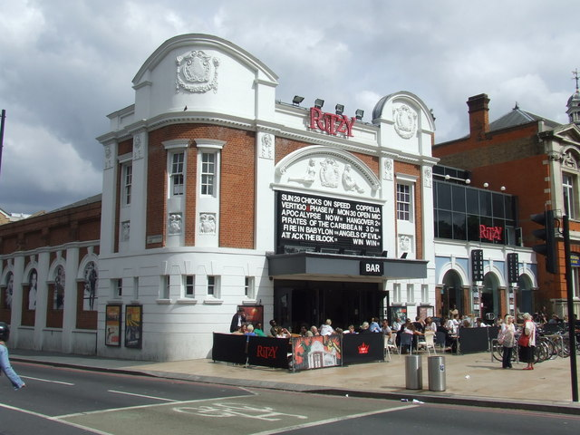


When your son/daughter has revised well – reward them!

Slide 7
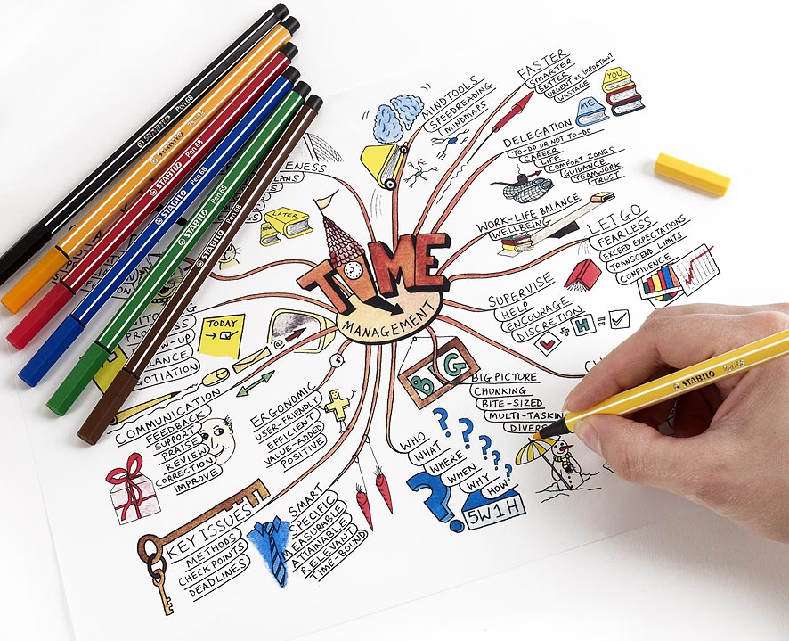
Revision: Planning (not cramming)!
Understanding how to make the most of the time available…
Notes:
Memory cyclic learning need to go over stuff three times
Revision timetable & all the resources you need
Learning check list for all subjects

Slide 8
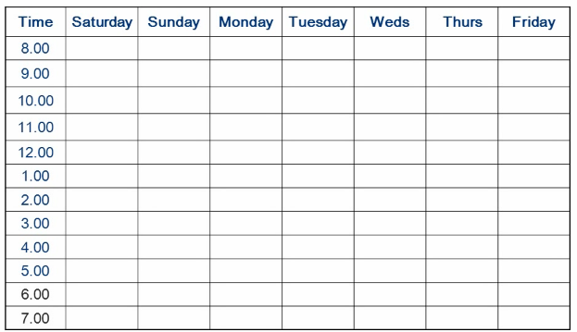
Work out the available hours in the week.

Slide 9
Put in social plans, rewards + mealtimes.
Lie
in
Lie
in
Gym
Breakfast
Breakfast
Breakfast
Gym
Breakfast
Breakfast
Tennis
Clarinet
See Gran
Lunch
Lunch
Lunch
Lunch
Lunch
Lunch
Lunch
Hair-dressers
Visit
Sarah
Piano
Gym
Film night
Gym
Film night
Gym
Gym
7 hours a day x 7 = 49 hours a week

Slide 10
Divide subjects into the total.
Lie
in
Lie
in
Gym
Breakfast
Breakfast
Breakfast
Gym
Breakfast
Breakfast
French 16
Maths 16
Psychology 17
TOTAL = 49
Tennis
Clarinet
See Gran
Lunch
Lunch
Lunch
Lunch
Lunch
Lunch
Lunch
Hair-dressers
Visit
Sarah
Piano
Gym
Film night
Gym
Film night
Gym
Gym
7 hours a day x 7 = 49 hours a week

Slide 11
Change the weighting to reflect priorities.
Lie
in
Lie
in
Gym
Breakfast
Breakfast
Breakfast
Gym
Breakfast
Breakfast
French 12
Maths 23
Psychology 14
TOTAL = 49
Tennis
Clarinet
See Gran
Lunch
Lunch
Lunch
Lunch
Lunch
Lunch
Lunch
Hair-dressers
Visit
Sarah
Piano
Gym
Film night
Gym
Film night
Gym
Gym
7 hours a day x 7 = 49 hours a week

Slide 12
Spread the first subject out through the week.
Lie
in
Lie
in
Gym
Breakfast
Breakfast
Breakfast
Gym
Breakfast
Breakfast
French
French
Tennis
French
French
French
Clarinet
See Gran
French
Lunch
Lunch
Lunch
Lunch
Lunch
Lunch
Lunch
French
French
Hair-dressers
French
French
French
Visit
Sarah
French
Piano
Gym
Film night
Gym
Film night
Gym
Gym
French = 12

Slide 13
Add the second subject.
Lie
in
Lie
in
Gym
Breakfast
Breakfast
Breakfast
Gym
Breakfast
Psych.
Breakfast
French
Psych.
French
Tennis
Psych.
French
Psych.
French
French
Clarinet
See Gran
French
Psych.
Lunch
Lunch
Lunch
Lunch
Lunch
Lunch
Lunch
Psych.
Psych.
Psych.
Psych.
French
Psych.
French
Psych.
Hair-dressers
French
French
Psych.
French
Visit
Sarah
French
Piano
Gym
Film night
Psych.
Gym
Film night
Gym
Psych.
Gym
Psychology = 14

Slide 14
Add the final subject.
Lie
in
Lie
in
Gym
Breakfast
Breakfast
Breakfast
Gym
Breakfast
Maths
Psych.
Maths
Breakfast
French
Psych.
French
Tennis
Psych.
Maths
Maths
French
Psych.
French
French
Clarinet
See Gran
Maths
Maths
Maths
Maths
French
Maths
Psych.
Lunch
Lunch
Lunch
Lunch
Lunch
Lunch
Lunch
Psych.
Maths
Maths
Maths
Maths
Maths
Maths
Psych.
Psych.
Psych.
Maths
Maths
French
Psych.
Maths
French
Psych.
Hair-dressers
French
French
Psych.
Maths
French
Visit
Sarah
French
Piano
Maths
Gym
Film night
Psych.
Gym
Maths
Film night
Gym
Maths
Psych.
Gym
Maths
This should be seen as a weekly ‘working’ document.
Maths = 23

Slide 15


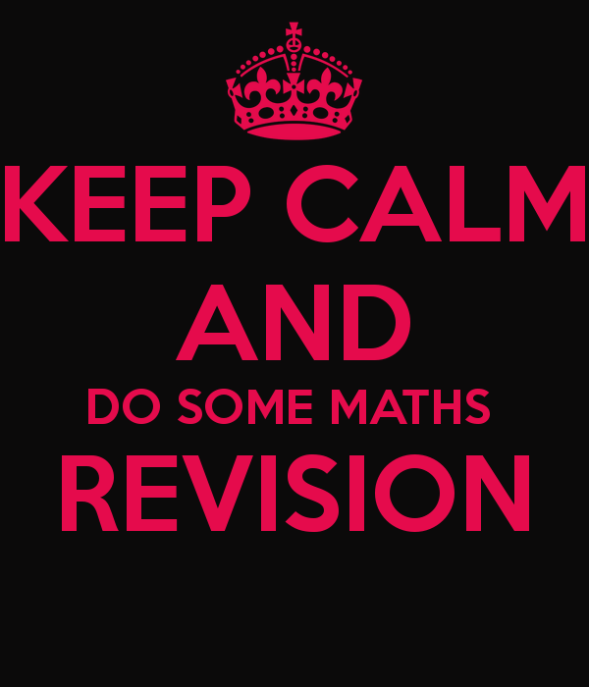
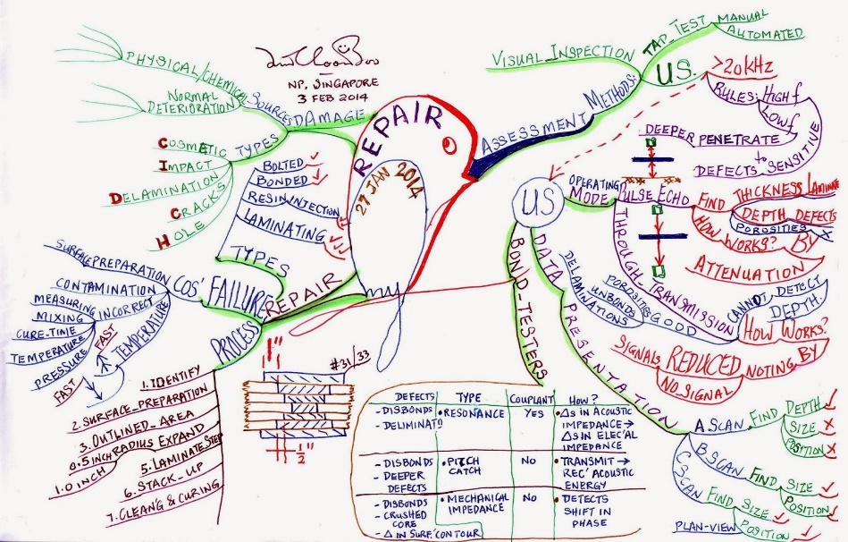
Revision Techniques

Slide 16
3 Phases:
Divide revision into three different phases:
Prepare It - get everything organised.
Learn It - doing things which will help to remember what is needed.
Test It - find out what is known and what needs to be worked on.
It’s always best to use a range of different ways to revise – sitting reading through books is not enough!

Slide 17
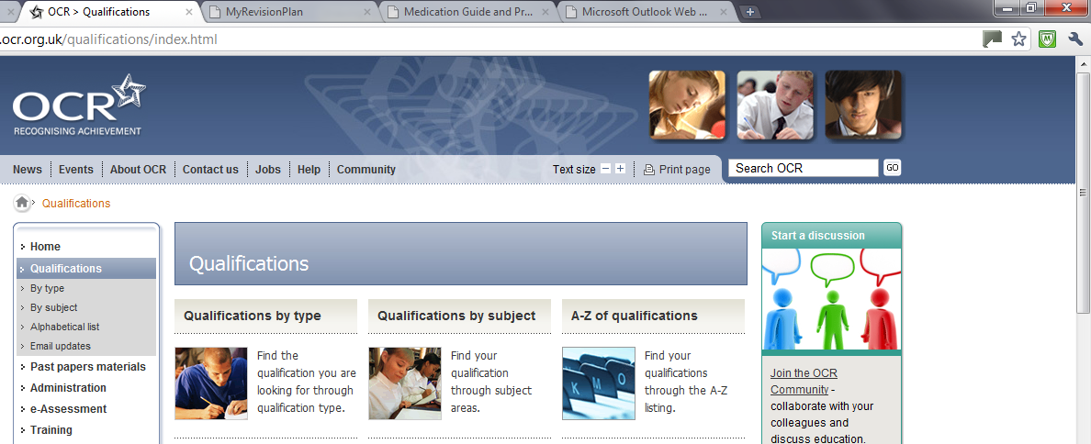
Use revision checklists or syllabuses for each subject as a starting point.
Try to identify gaps in knowledge.
They can be easily found online or ask member of staff.

Slide 18
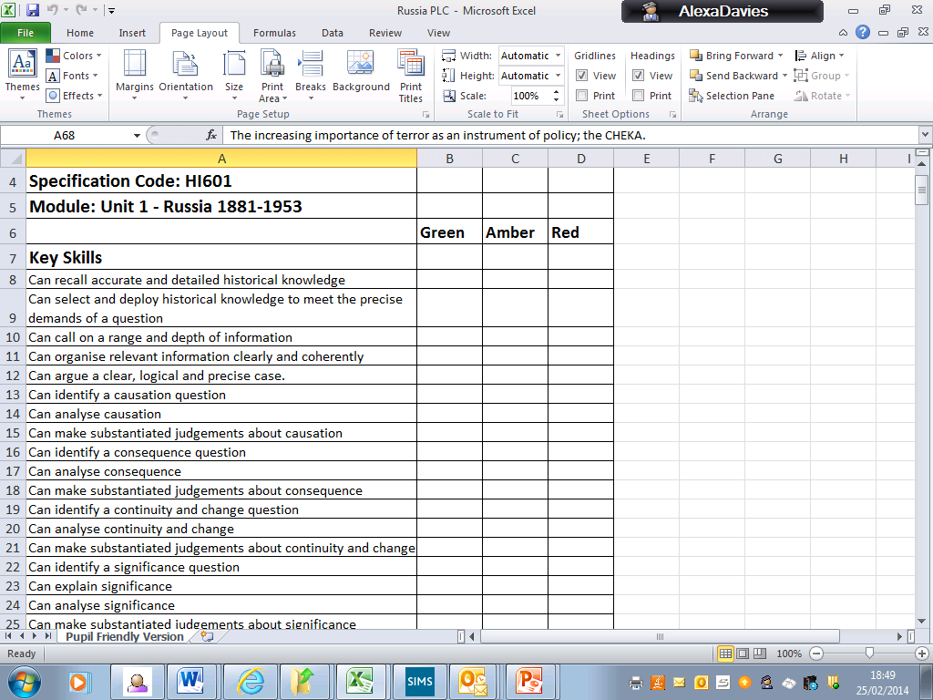
What is known already? Knowledge audit

Slide 19

A common mistake:
More time is often spent revising for things that are already known, instead of things found difficult.

Slide 20
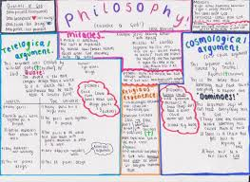

Make posters of key notes, facts and equations and stick them around the house where they can be seen (in places spent the most).

Slide 21


Reduce/
condense notes!
Step 1 – start BIG (A3)
Step 2 – reduce/condense (A4)
Step 3 – reduce again (revision cards

Slide 22
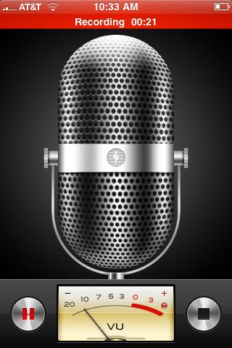
Record notes to listen to.
Most smart phones have a voice recording facility and there are so many free online programmes.
The creative could create a song of their notes, or a play list with speaking over the top.
This techniques is very helpful for MFL.

Slide 23
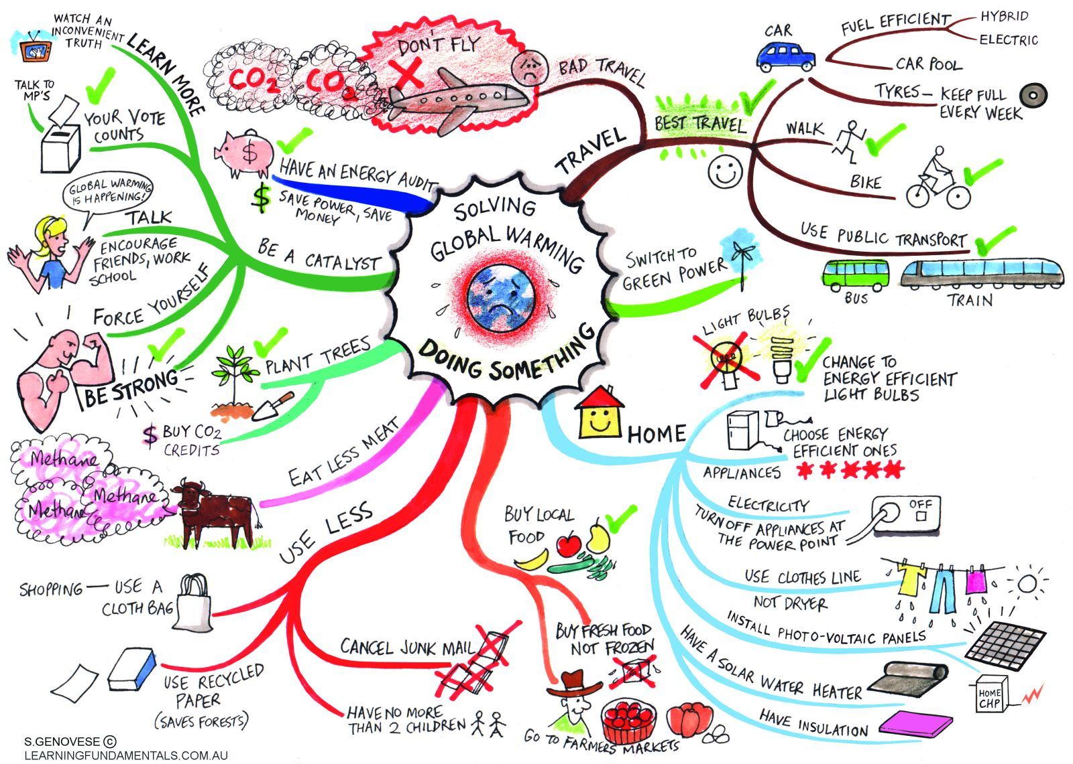
Create memory aids such as diagrams or mind maps.
There are lots of free online mind mapping tools.

Slide 24
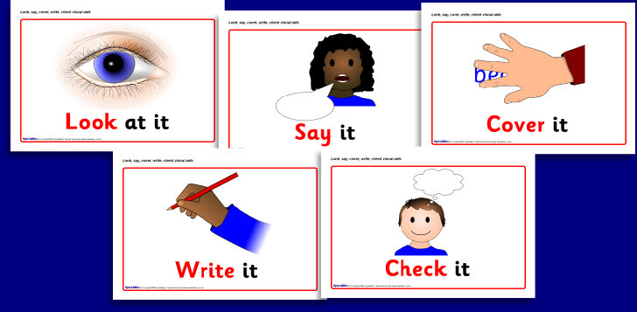

Slide 25
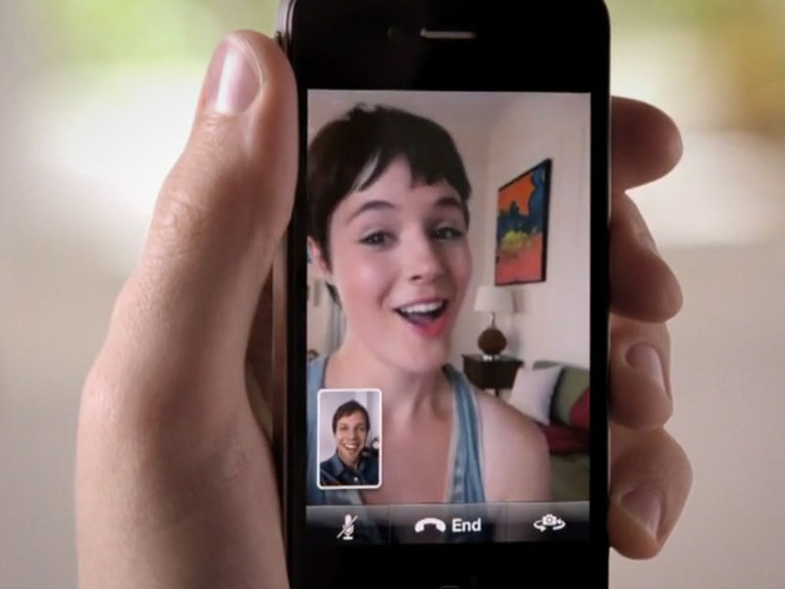
Collaboration:
Studying with friends or parents and test knowledge.
Remember you are meeting to revise rather than to chat!
Facetime/Skype/
WhatsApp can work very well for students who are revising from their own study areas.

Slide 26
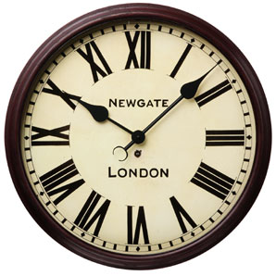

Exam questions and papers under timed conditions
You can get these from teachers or online.
You can also download mark schemes to give the answers and examiners’ reports which point out common errors.

Slide 27

Why are we doing this?
This is for your son/daughter
Success in exams is not the be all and end all in life BUT IT DOES HELP!
Exams do mean grades and good grades mean a better chance of a good job or further and higher education, a career and opportunities.
Encourage them not to throw opportunities away because they are too lazy or impatient for the summer to begin.
GCSEs are not impossible; they are designed for most people to do well in.
Help them set a target and go for it!

